Slide 1
Modeling Pooled-Testing for covid-19 with correlated samples
Saskia Comess
Claire Donnat
Holmes Group Meeting, 5 March

Slide 2
Research Objectives
Demonstrate changes in pooled testing efficiency when accounting for natural deviations from IID hypotheses in the specimen collection process.
We investigate the effect of these two main deviations from the standard hypotheses on the average and tails of the distribution of efficiency metrics (positive percent agreement (PPA), expected number of tests per sample)
Compute mathematically and demonstrate via Monte Carlo simulations.
Develop RShiny interface for identifying optimal group testing parameters.
Investigate how pooled sampling can allow us to estimate global quantities, such as the overall prevalence.
Make practical recommendations for testing.
Notes:
In contrast to other existing studies, we frame this problem as a distortion of the law of probability of the number of positive samples per pool — thereby allowing us to compute a correction to existing abaci, the impact on the volatility of metrics of interest, and preserving the ease of its deployment, rather than framing it within a standard optimization strategy.
PPA is analogous to sensitivity when a non-reference standard test is used
Positive agreement is the proportion of comparative/reference method positive results in which the test method result is positive.

Slide 3
overview
BACKGROUND
Mass testing is needed to control the COVID-19 outbreak, but testing resources limited
Pooled testing: advantages and challenges
Pooled testing in non-IID settings: effective parameters, effect on PPA and tests per sample
Impact of heterogeneity on predictive metrics
Extrapolating to global prevalence estimates
Develop recommendations for testing based on groups of differing risks
Notes:
Key principles for successful application of group testing involve knowledge of the limit-of-detection, sensitivity, and specificity of the assay, and the prevalence of disease in the population. The goal of the process is to determine a pool size that provides the greatest conservation of resources while maintaining the reliable performance of testing.
STANFORD POOLED TESTING PERFORMANCE STUDY
Characterized effect of dilution on analytical sensitivity through sample pooling using empiric data and modeling
Assumes all samples are independent and identically distributed
CORRELATION STRUCTURES
How does test sensitivity change when iid assumptions are violated?
Two models for introducing correlations
Correlation in C_{t} values
Correlation at transmission level (network model)

Slide 4
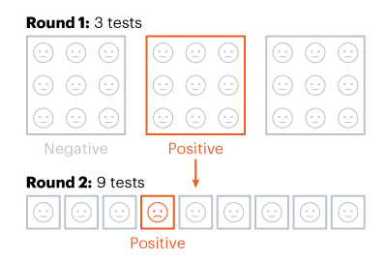
Background
Pooled testing: combining samples from several people and conducting one laboratory test on the combined pool of samples
Dorfman 2-stage pooling →
More complicated methods may be more “optimal”, but 2-stage Dorfman is practical
Notes:
If a pooled sample is negative, all individuals in the pooled sample are deemed negative. If the pooled sample is positive, the individual samples from the pool are then tested.
https://www.cdc.gov/coronavirus/2019-ncov/lab/pooling-procedures.html
https://idss.mit.edu/wp-content/uploads/2020/04/04.28.2020pooled_testing.pdf
https://www.nature.com/articles/d41586-020-02053-6

Slide 5
Motivation: why group test?
Studies suggest that frequent, extensive testing with rapid results successfully reduces transmission in an epidemic setting
In practice, testing needs have outstripped availability in many parts of the world

Slide 6
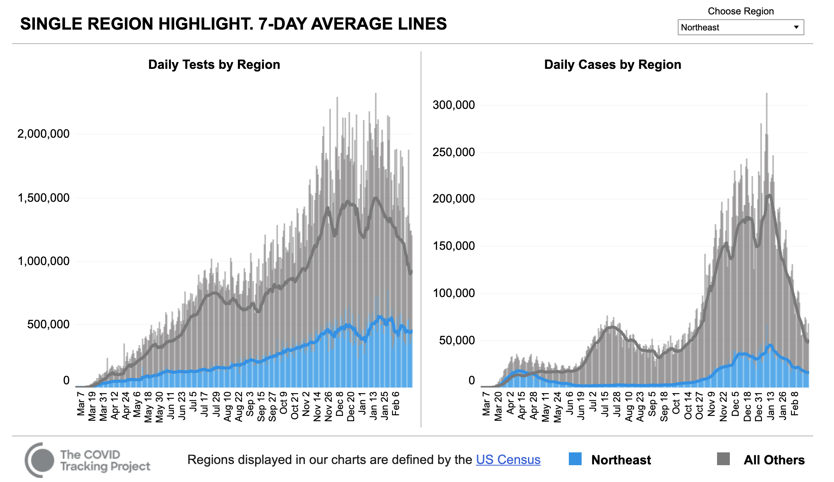
Notes:
https://covidtracking.com/data/charts/compare-one-region-to-others

Slide 7
Nonpartisan report warns of COVID-19 testing shortages in over half US states, territories [ABC News, nov. 2020]
A Rush On Coronavirus Testing Strains Laboratories, Drives Supply Shortages
[NPR, Nov. 2020]
FDA issues first emergency use authorization for Covid-19 pool testing
[CNN, July, 2020]
The mathematical strategy that could transform coronavirus testing [Nature, July 2020]
Stanford Health Care can begin pooled testing for COVID-19 [Stanford News, July 2020]
Notes:
https://www.cnn.com/2020/07/18/health/pool-testing-fda-authorization/index.html
https://www.bostonglobe.com/2020/11/17/opinion/pooled-covid-19-testing-can-help-keep-kids-school/
https://www.nature.com/articles/d41586-020-02053-6
https://med.stanford.edu/news/all-news/2020/07/stanford-health-care-can-begin-pooled-testing-for-covid-19.html

Slide 8
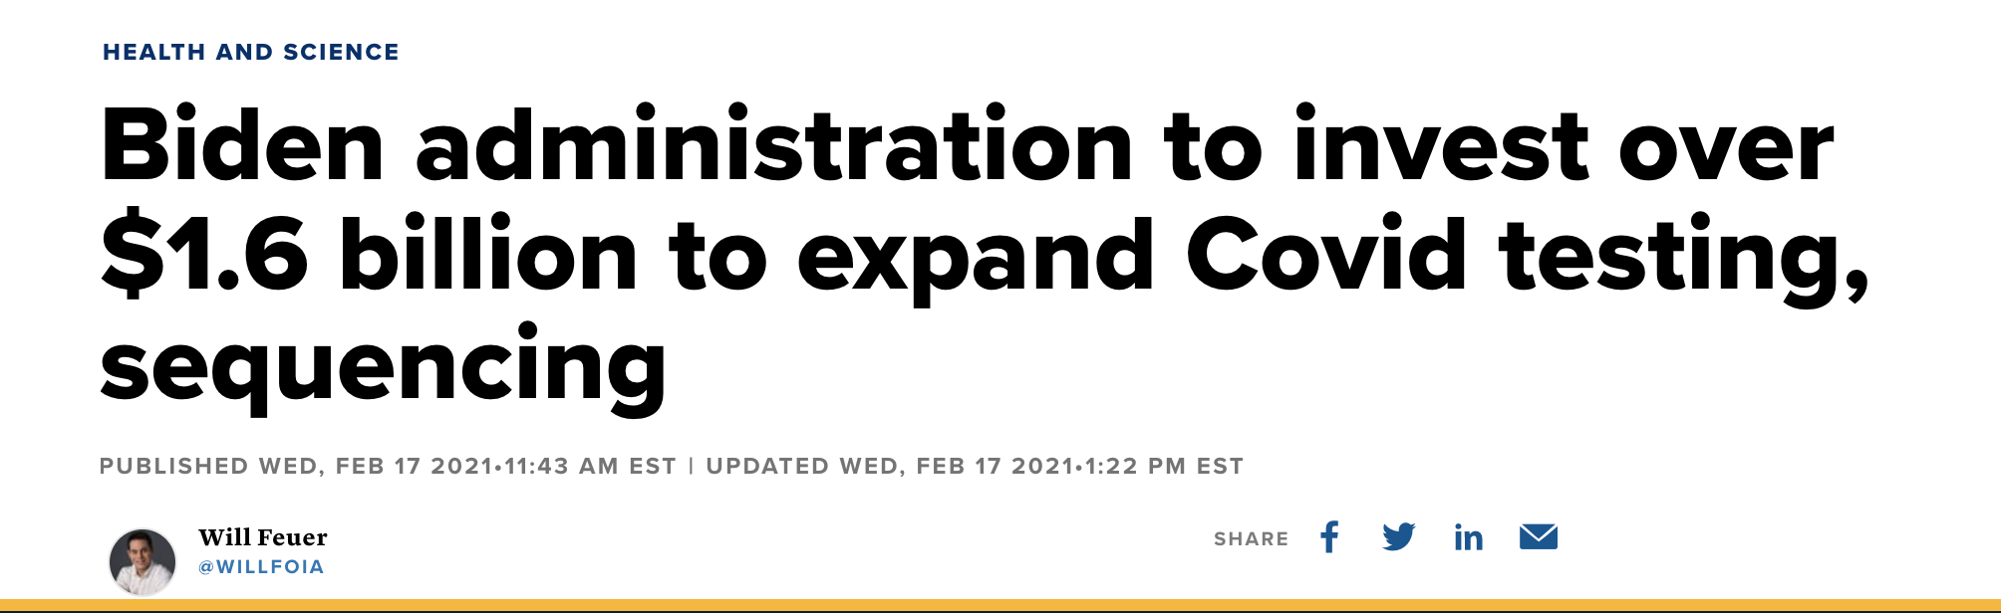
“The Biden administration announced Wednesday that it will invest more than $1.6 billion to increase Covid-19 testing supplies and expand testing programs in schools and elsewhere as well as boost genomic sequencing in the United States.
“We need to test broadly and rapidly to turn the tide of this pandemic,” Carole Johnson, the White House’s Covid-19 testing coordinator, said at a news briefing. “But we still don’t have enough testing and we don’t have enough testing in all the places it needs to be.”
Notes:
https://www.cnbc.com/2021/02/17/biden-administration-to-invest-over-1point6-billion-to-expand-covid-testing-sequencing.html

Slide 9
The pooled testing tradeoff
Advantages
Minimize average number of tests per person
More testing using fewer resources
Limitations
Optimal Pool Size, Feasibility of strategy
Dilution & Analytic Sensitivity
Disease Prevalence
This trade-off has often been studied in settings where the specimens are considered independent and identically distributed (IID), showing moderate efficacy gains compared to individual testing
SARS-CoV-2 virus: these assumptions are often violated
How does this change our recommendations for implementation of pooled testing?
Notes:
Key principles for successful application of group testing involve knowledge of the limit-of-detection, sensitivity, and specificity of the assay, and the prevalence of disease in the population. The goal of the process is to determine a pool size that provides the greatest conservation of resources while maintaining the reliable performance of testing.
TRADEOFF: larger pools save more resources, but they also dilute samples more and make it harder to detect presence of virus
Nebraska public health study: https://academic.oup.com/ajcp/article/153/6/715/5822023

Slide 10
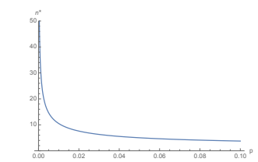
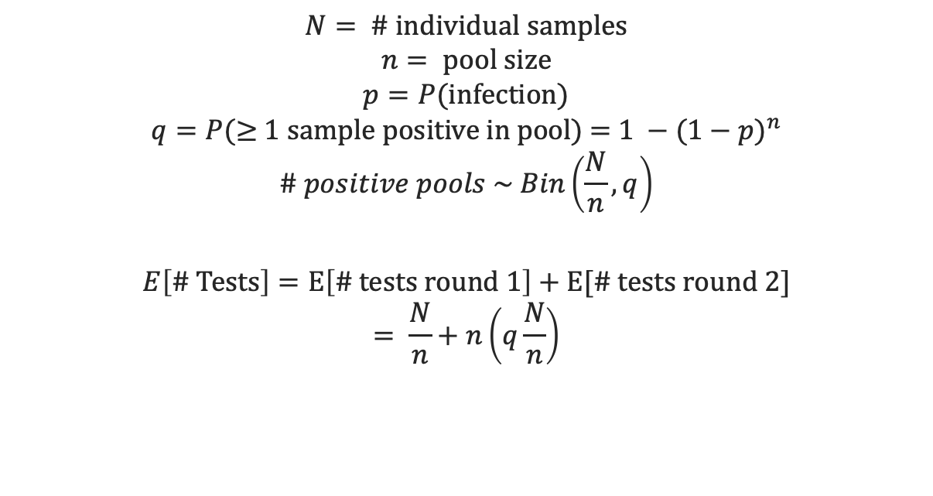
Efficiency: Homogenous population, independent samples
$$N= \text{\# }\text{individual} \text{samples}$$
$$n= \text{pool} \text{size}$$
$$p=P(\text{infection}\text{)}$$
$$q=P(\text{≥}\text{ 1 }\text{sample} \text{positive} \text{in} \text{pool}\text{) = }1 −{(1−p)}^{n}$$
$$\# positive pools \sim Bin\left(\frac{N}{n}, q\right)$$
$$E\left[\text{\# }\text{Tests}\right]=E\left[\# tests round 1\right]+E[\# tests round 2]$$
$$= \frac{N}{n}+n\left(q\frac{N}{n}\right)$$
Optimal pool size for Dorfman testing as a function of prevalence
Notes:
Traditionally, the samples mixed in a group are assumed to be independent and identically distributed Bernoulli random variables.
Decomposing this expectation, we have N/n pools to test in the first round and then n times the number of positive pools to test in the second round. The number of positive pools from the first round is a random variable and is distributed Binomial(N/n, q) with expectation q(N/n)
https://idss.mit.edu/wp-content/uploads/2020/04/04.28.2020pooled_testing.pdf
** assuming perfect sensitivty

Slide 11
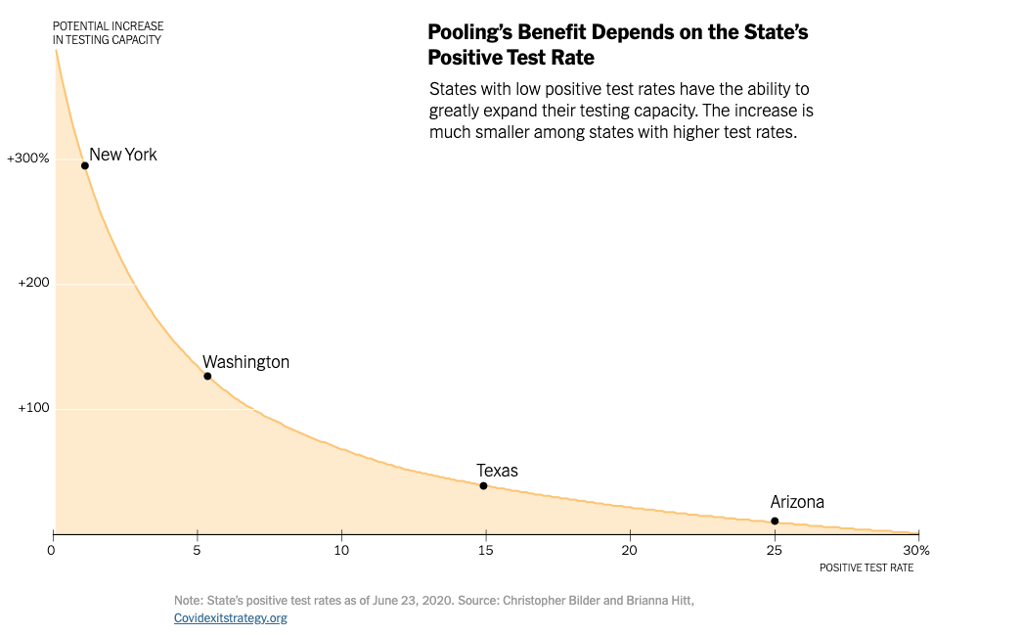
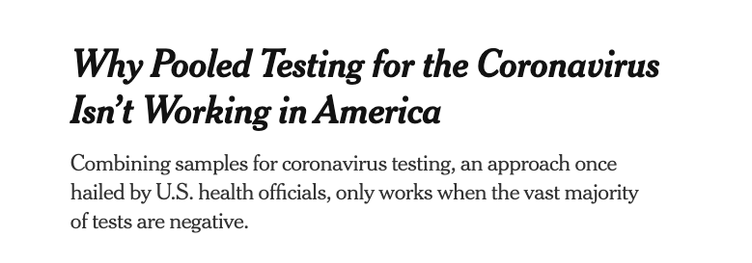
prevalence
PREVALENCE: Efficiency of pooled testing strategy decreases as prevalence increases
Lower prevalence → larger optimal pool size, less retesting needed
Most efficient when prevalence is at least less than 5% (possibly < 1%?)
Nebraska Public Health Study: one positive sample + four negatives reduced number of tests by >50 when COVID-19 prevalence < 5%
Notes:
Disease prevalence determines the probability that a pool contains at least one positive individual, and therefore, that all individuals in the pool require re-testing [29] — reducing efficacy of the method in high prevalence settings.
Nebraska public health study: https://academic.oup.com/ajcp/article/153/6/715/5822023
NYTimes: https://www.nytimes.com/2020/08/18/health/coronavirus-pool-testing.html
https://www.nytimes.com/interactive/2020/07/27/upshot/coronavirus-pooled-testing.html?action=click&module=RelatedLinks&pgtype=Article

Slide 12
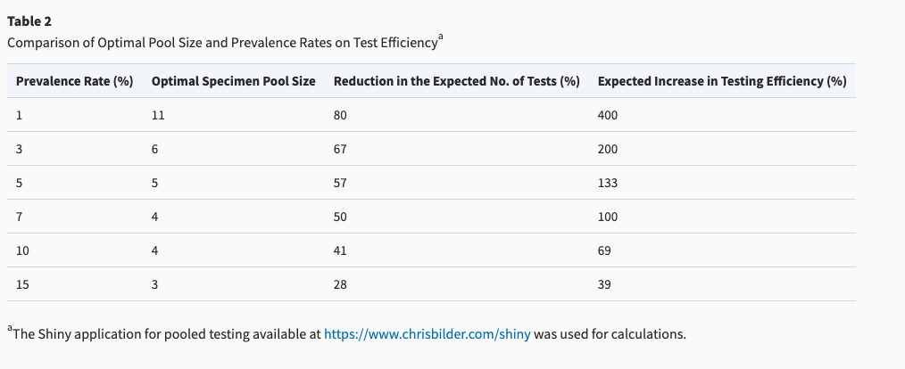
Tradeoff between prevalence and pool size
Notes:
https://academic.oup.com/ajcp/article/153/6/715/5822023

Slide 13
DILUTION & ANALYTIC SENSITIVITY
Sensitivity = proportion of people who have disease that are correctly identified as positive
Combining specimens → dilution → lower concentration of viral genetic material, possibly below the limit of detection of test
Larger pools → higher probability of false-negatives
C_{t} Value = Cycle Threshold Value
Number of PCR cycles needed to detect the virus
No detection after 37 to 40 cycles = negative test
Indicates how much virus an infected person has
Notes:
Pooling samples can also potentially dilute the viral genetic material of a positive sample beyond the assay’s Limit of Detection (LoD), thus increasing the likelihood of false negative results
A test that registers a positive result after 12 rounds, for a CT value of 12, starts out with more than 10 million times as much viral genetic material as a sample with a CT value of 35)
low Ct values indicated the presence of higher amounts of viral RNA and high Ct values indicated lower amounts.
Pooling samples INCREASES the Ct

Slide 14
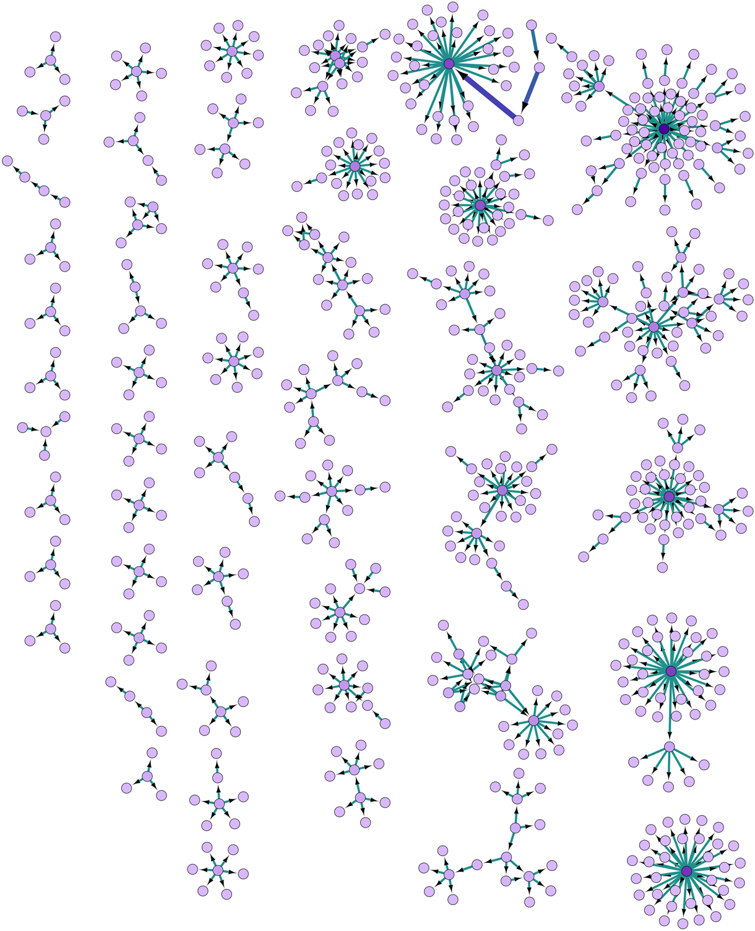
Pooling strategy
“Routine” approach: first sample pools are assembled randomly in the laboratory for analysis
Assumes samples are independent! (# positives in a group has binomial distribution)
Valid for COVID-19?
Relations between individuals (families, office colleagues or neighbors, passengers on airplane) determine risk of infection
Could form homogeneous pools of correlated individuals
Notes:
IID: assume that the underlying diagnostic for any given individual is independent of other test results in the pool, and that each individual has the same probability of infection. This is how Dorfman pooling procedure is typically done
not realistic: In many SARS-CoV-2 collection scenarios, infections and positive specimens are clustered and individuals have heterogeneous infection risks de- pending on a number of variables including age, lifestyle, or occupation (among others). In particular, the sample collection process might lend itself to sample certain networks, such as student dorms, coworkers in an office, households, etc
Additional notes:
Figure from https://www.cambridge.org/core/journals/epidemiology-and-infection/article/social-network-analysis-of-covid19-transmission-in-karnataka-india/EDFB0A9733D163B3ED7D4271B3C50C13
Decekert et al. 2020- Comparing routine to context-sensitive pooling approaches: https://www.ncbi.nlm.nih.gov/pmc/articles/PMC7463190/pdf/BLT.20.257188.pdf
Simple Dorfman procedure assumes samples are IID - but in reality they are not identically distributed (risk factors) and not independent (correlated)
these considerations are somewhat novel to coronavirus, because group testing not previously used on such a wide scale

Slide 15
Objectives
Impact of heterogeneity on predictive metrics
Extrapolating to global prevalence estimates
Develop recommendations for testing based on groups of differing risks
Pooled testing in non-IID settings: effective parameters, effect on PPA and tests per sample
When IID assumptions are violated, this shifts the effective number of samples and prevalence level.
Neglecting interactions and variability in infection risk yields inaccurate estimates of the efficiency of pooled testing through a biased reading of established optimality grids that make IID assumptions
Correlations and heterogeneous risk are a systematic bias correction problem: the effective sample size and expected prevalence are different from the observed ones
We focus on mapping from observed to effective pool size and prevalence, so as to appropriately transform the existing optimal pooling strategy abacus
Notes:
These deviations from standard hypotheses can shift the optimal pool size by modifying the inputs along two orthogonal dimensions:
effective pool size is typically smaller than actual pool size, due to violations of the independence assumptions and,
effective prevalence can differ from global prevalence due to violations of the “identically distributed” hypothesis

Slide 16
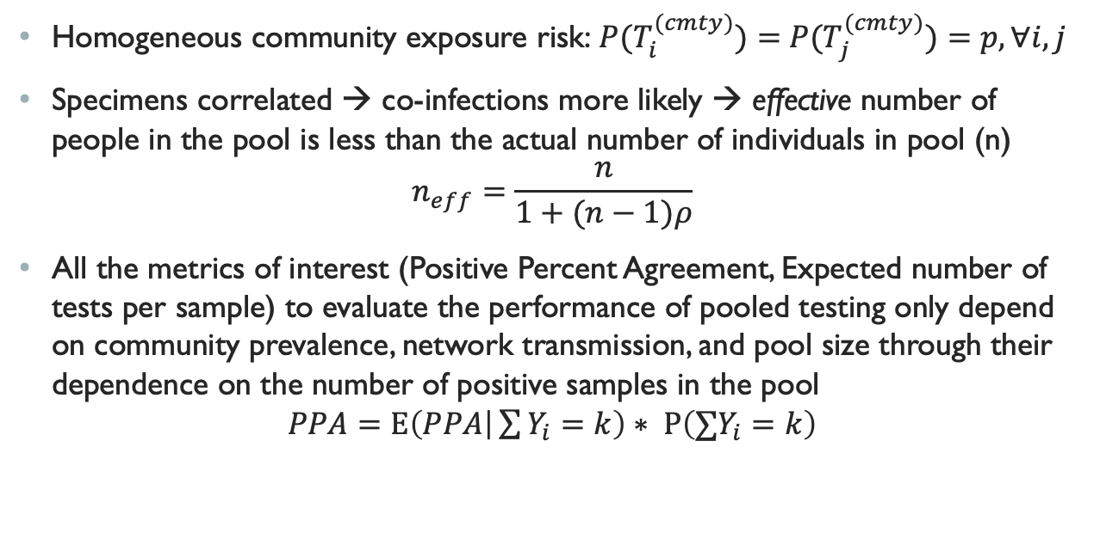
Homogeneous community exposure risk, non-independent
Homogeneous community exposure risk:${ P(T}_{i}^{(cmty)})={ P(T}_{j}^{(cmty)})=p, ∀i,j$
Specimens correlated → co-infections more likely → effective number of people in the pool is less than the actual number of individuals in pool (n)
$$n_{eff}=\frac{n}{1+(n−1)ρ}$$
All the metrics of interest (Positive Percent Agreement, Expected number of tests per sample) to evaluate the performance of pooled testing only depend on community prevalence, network transmission, and pool size through their dependence on the number of positive samples in the pool
$$PPA=Ε\left(PPA | \sum{Y_{i}}=k\right)∗ Ρ\left(∑Y_{i}=k\right)$$
Notes:
This scenario corresponds to a specimen collection process in student dorms, offices, or certain households
In this setting: Intuitively, probability p is higher than community prevalence because Specimens have the added risk of being infected by other members of the network. Moreover, since specimens are correlated, co-infections are much more likely than under H0: the “effective” number of people in the pool is less than n
Rho = the correlation between Y_i and all the other samples in the group

Slide 17
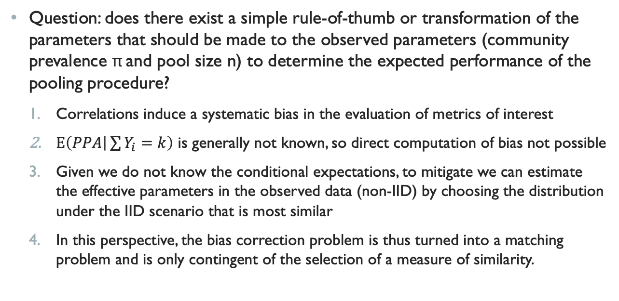
Homogeneous community exposure risk, non-independent
Question: does there exist a simple rule-of-thumb or transformation of the parameters that should be made to the observed parameters (community prevalence π and pool size n) to determine the expected performance of the pooling procedure?
Correlations induce a systematic bias in the evaluation of metrics of interest
$Ε\left(PPA | \sum{Y_{i}}=k\right)$ is generally not known, so direct computation of bias not possible
Given we do not know the conditional expectations, to mitigate we can estimate the effective parameters in the observed data (non-IID) by choosing the distribution under the IID scenario that is most similar
In this perspective, the bias correction problem is thus turned into a matching problem and is only contingent of the selection of a measure of similarity.
Notes:
to mitigate this bias, it is sufficient to minimize the distance between the distribution Ha(π,N,n,τ) with correlations and the family of distributions under the null model H0
So we want to examine effective parameters, where effective parameters (Ne,πe) can be defined as the parameters which allow to find the distribution which is the most similar to Ha(π,N,n,τ) in family of distributions FH0 .
Mathematically we define “closest” in terms of minimizing the likelihood ratio (other definitions exist too for minimizing distance between distributions: e.g. Kullback Leibler and Total Variation distance)

Slide 18
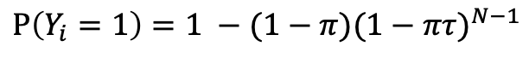
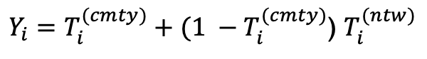
Effective Parameters in non-iid settings: positives per pool
Specimen i infected
Community transmission probability (prevalence) $π$
Community transmission probability (prevalence) 𝜋
Network transmission probability
$$τ$$
Network transmission probability
𝜏
$Y_{i}=T_{i}^{(cmty)}+(1 −T_{i}^{(cmty)}$) $T_{i}^{(ntw)}$
In the presence of correlations in a fully connected network of size N, the probability that any given individual is infected is greater than the population prevalence ($π)$ and increases with the network transmission rate ($τ$)
$$Ρ\left(Y_{i}=1\right)=1 −(1−π){(1−πτ)}^{N−1}$$
Notes:
n= number of samples in each pool,
N = size of network to which the samples belong
(For now we assume n= N)
Tau = network transmission probability between individuals in the pool
Pi = population prevalence (community transmission probability)
Yi the indicator variable that specimen i is infected (Yi = 1 if individual i infected, 0 otherwise).
Since transmission can occur within the network or in the community, we decompose Yi as follows:
Let T(cmty) be the random variable indicating infection of individual i from outside i the group (community transmission), and
Let T(ntw) indicate infection from within the group i (network transmission).

Slide 19
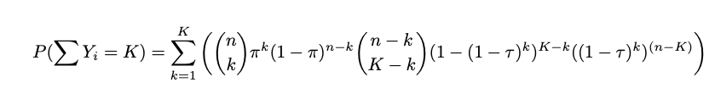
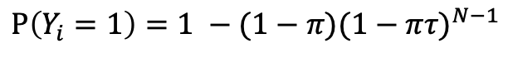
Effective Parameters in non-iid settings: positives per pool
Probability of observing k positives in n trials with success probability
$$Ρ\left(Y_{i}=1\right)=1 −(1−π){(1−πτ)}^{N−1}$$
Notes:
Fig 2. Probability of k tests positive for a given pool size (0-20), population prevalence (0.001,...,0.1) of disease, and transmission probability within the network (τ ∈ (0.1, 0.5)).
In panel 2b, probabilities are calculated using specified equation, allowing for infections in a group to be acquired in the community and via network transmission.
binomial distribution (probability of observing k positives in n trials (pool size) with success probability 1 − (1 − π)(1 − πτ )n−1 (corrected population prevalence)). The population prevalence is corrected to account for the fact that the probability of an individual being positive in a pool is greater when τ is greater than π.
Observations: by definition probability that a pool has zero positives is equal for all methods. he probability of seeing a larger number of positive individuals in a pool increases both as prevalence increases and as the network transmission rate increases
Probability that pool tests positive is the same if you have a perfect test
But test is not perfect – more positives in a pool affects dilution -> changes probability that test comes back positive
All the metrics m of interest (Positive Percent Agreement, Expected number of tests per sample) to evaluate the performance of pooled testing only depend on τ,n,N and π through their dependency on the number of positive samples in the pool

Slide 20
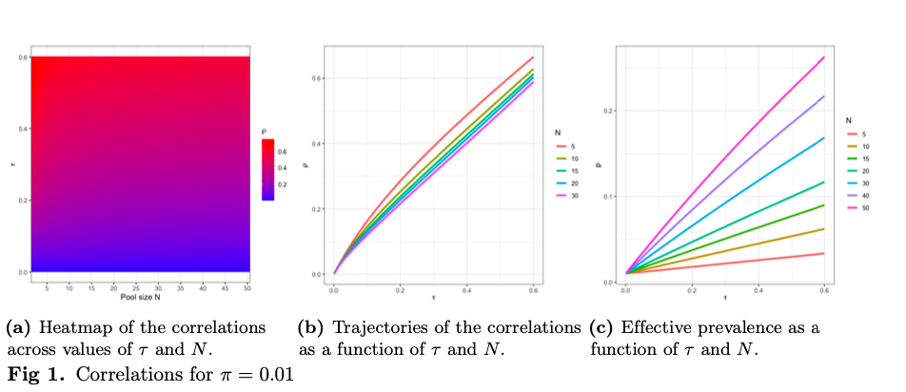
Effective Parameters in non-iid settings: Correlation & prevalence
Notes:
Tau is a generic notion of transmission between individuals – want to map it back to correlation between two samples in the pool. Here, correlation between two samples in a pool is a function of pi, tau and N. When we have small values of pi and N, the correlation simplifies to just a function of tau and N
In the null model, the probability p of each individual sample being positive equals the community prevalence. Here we examine the effective prevalence
(a) Across all pool sizes, as the transmission probability between individuals in the pool (tau) increases, correlation increases
(b) Shows same thing as (a)
A and b show that for small pi (and reasonable network sizes), the correlation is roughly similar to the transmission rate and it is independent of the prevalence
(c) As tau increases, the effective prevalence increases across all group sizes

Slide 21
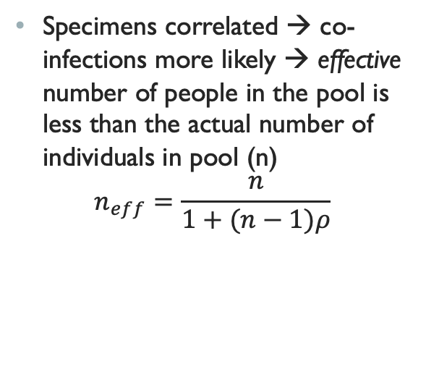
Effective Parameters in non-iid settings: pool size
Specimens correlated → co-infections more likely → effective number of people in the pool is less than the actual number of individuals in pool (n)
$$n_{eff}=\frac{n}{1+(n−1)ρ}$$
Notes:
since specimens are correlated, co-infections are much more likely than under H0: the “effective” number of people in the pool is less than n.

Slide 22
Simulations: Homogeneous community exposure risk, non-independent
Model PPA and effective number of tests per sample as a function of:
1) Community Prevalence ($π$): 0.1%, 1.0%, 3.0%, 5.0%, 10.0%, 15.0%
1) Community Prevalence (𝝅): 0.1%, 1.0%, 3.0%, 5.0%, 10.0%, 15.0%
3) Viral load distribution:
% of individual amplified C_{t} values above the LoD- 5%, 10%, 15%, 20%, 25%, 30%
Constant: Assay analytical sensitivity:
95% assay limit of detection (LoD) C_{t} = 35
2) Pool size: 1-20
C_{t} value corresponding to the probability of detecting 95% of true positives (95% LoD). Specimens with C_{t} > LoD are assigned a decreasing probability of detection based on a probit regression curve (derived from empiric data)
Stochastic model adapted from Wang, et al. (provided by Pinsky lab)
Notes:
We have so far considered the bias in individual parameters that non-IID assumptions induces. Now we want to consider the effect on the entire distribution. We do this via simulation
To illustrate the mathematical results that we have just shown, we adapt the stochastic model originally developed by the Pinsky lab for estimating PPA and efficiency for a two-stage pooled testing algorithm to a setting where individuals’ infection statuses (positive vs. negative) are correlated. We consider two settings: one is which we assume to test the entire network at once (in which case n = N) and one for which we only test a part of the network (n < N). For now I will just talk about the setting where we test the entire network at once
at each Ct value you have a probability of detection; above LoD (35) definitely negative, below the LoD its stochastic and there is a probability of being positive. lower Ct means easier detection
increasing proportion of positive tests is like increasing prevalence in the general population
We account for potential variability in the distribution of Ct values across subjects by fitting a Weibull distribution to empirically collected Ct distribution data, and subsequently sampling to create mock distributions where Ct values are shifted above the 95% LoD of the assay by any percentage of interest. We repeat our simulations accounting for varying proportions of the Ct values above the 95% assay LoD (x: 5.0%, 10.0%, 15.0%, 20.0%, 25.0%, 30.0%) as well. Results are presented for 15.0% of Ct values above the 95% assay LoD

Slide 23
Simulations: Homogeneous community exposure risk, non-independent
For each combination of prevalence and pool size (and % greater than LoD), we calculate the expected number of tests per sample and the PPA, both weighted by the probability of observing k positives in that pool
True population: correlated individuals
Null mode: Ignore correlation – erroneously treat as IID
Expected number of positives per pool has binomial distribution
Alternative: Correctly consider networks of correlated individuals
Expected number of positives per pool computed exactly
Notes:
Simulate as if testing a population of correlated individuals, where we either ignore correlation and erroneously treat the individuals as independent (H0), or correctly consider networks of correlated individuals (Ha). Probabilities are calculated as specified on the previous slides:
null model, we make i.i.d assumptions and the expected number of positives per pool has a binomial distribution (probability of observing k positives in n trials (pool size) with success probability 1 − (1 − π)(1 − πτ )n−1 (corrected population prevalence)). The population prevalence is corrected to account for the fact that the probability of an individual being positive in a pool is greater when τ is greater than π.
alternative model Ha, the probability of K positives is computed exactly under two scenarios using Equation 7 and Equation 8 (the equations I showed previously), which correspond to Poisson Binomial distributions.

Slide 24
Simulations: Homogeneous community exposure risk, non-independent
Model-estimated PPA (A) and average tests per sample (B), by pool size, prevalence, and within network transmission probability (τ), where τ is homogeneous within and between all pools.
Notes:
Proportion of samples with Ct above the 95% LoD (held constant at LoD = 35) is constant, equal to 15%. Correlation structure within a pool (indicated by line type) determines the weighting probability for calculating PPA. When pool size equals 1, this is equivalent to a non-pooled testing baseline.
For uncorrelated samples expected PPA is highly dependent on pool size and prevalence: shape of the uncorrelated sample curves depends on the prevalence: when prevalence is greater than about 5%, expected PPA initially decreases with increasing pool size, then increases for larger pool sizes because there is a greater likelihood of two positive samples being in the same pool. At lower prevalence, expected PPA continuously decreases.
correlated samples: PPA actually increases with increasing pool size for correlated samples, regardless of other factors. Similarly, as the transmission probability within the network increases, PPA becomes less dependent on the population prevalence of disease
These violations shift the effective number of samples and prevalence level. Neglecting interactions and variability in infection risk yields inaccurate estimates of the efficiency of pooled testing through a biased reading of established optimality grids

Slide 25
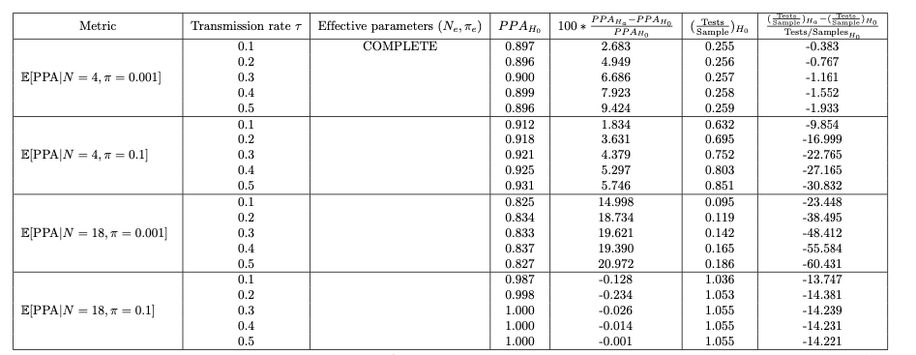
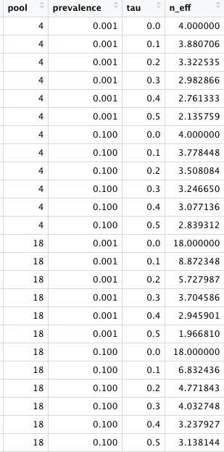
Simulations: Homogeneous community exposure risk, non-independent
Percent increase in expected PPA and percent decrease in expected tests per sample for the null versus alternative models, for selected values of group size and prevalence.
Notes:
shows the expected percent increase in PPA and expected percent decrease in number of tests per sample when samples are uncorrelated (i.i.d) versus correlated
With large tau, small population prevalence, and large group size, expected PPA is over 20% higher in the alternative model. Similarly, the alternative model results in a lower expected number of tests per sample for all settings. The greatest reduction in number of tests again occurs with large tau, small population prevalence, and large group size, where there is an over 60% reduction in the number of tests expected.

Slide 26
Objectives
Pooled testing in non-IID settings
Extrapolating to global prevalence estimates
Develop recommendations for testing based on groups of differing risks
Impact of heterogeneity on predictive metrics
How to select the transmission rate given data?
What is the impact of the added effect of this heterogeneity? – i.e. how to provide confidence bounds to the simulations shown previously
Notes:
Compared to existing studies, we aim to provide confidence bounds, and account for the variability in correlations and exposure risks in the population.
NON-IID SETTINGS
How does expected performance of pooling procedure change when IID assumptions are violated?
Mathematical derivation and simulation
IID: assume that the underlying diagnostic for any given individual is independent of other test results in the pool, and that each individual has the same probability of infection
not realistic: In many SARS-CoV-2 collection scenarios, infections and positive specimens are clustered and individuals have heterogeneous infection risks de- pending on a number of variables including age, lifestyle, or occupation (among others). In particular, the sample collection process might lend itself to sample amongst networks, as measures to re-open might test student dorms, coworkers in an office, households, etc

Slide 27
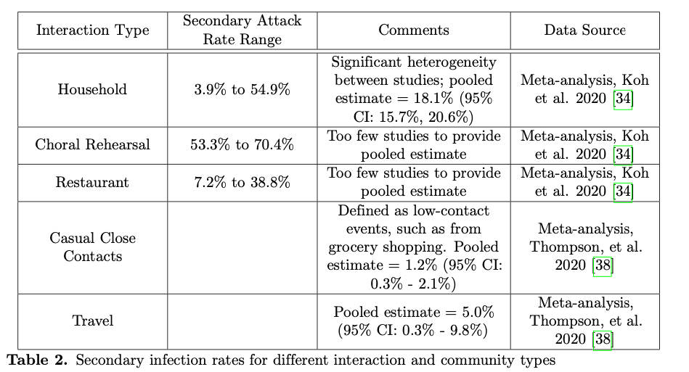
Heterogeneity in transmission
Notes:
Transmission estimates vary vastly across studies and subjects. Similarly, among people in the same community, exposure risks vary depending on one’s occupation (healthcare workers, school teachers, retailers, or remote workers) — thus begging the question: in light of this heterogeneity, how to select the transmission rate? What is the impact of the added effect of this heterogeneity? In other words, the focus of this section is on providing confidence bounds to the curves provided in the previous section.
Shows magnitude of correlation and significant variability

Slide 28
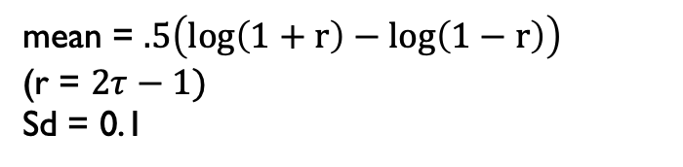
Simulations: Homogeneous community exposure risk, non-independent
Model-estimated PPA (A) and average tests per sample (B), by pool size, prevalence, and within network transmission probability (τ), where τ is homogeneous within a pool but heterogeneous between pools. The τ value indicates the point estimate, and individual groups are assigned a τ_{i} sampled from a normal distribution with
mean = $.5\left(log\left(1+r\right)−log\left(1−r\right)\right)$
(r = $2τ−1)$
Sd = 0.1
Notes:
We additionally compute results for deterministic values of τ as well as by transforming a point estimate of τ and sampling from a normal prior with mean equal to the transformed point estimate of τ and sd equal to log(m)/2 where m is the relative ratio of variation expected to be seen in τ.
Proportion of samples with Ct above the 95% LoD (held constant at LoD = 35) is constant, equal to 15%. Correlation structure within a pool (indicated by line type) determines the weighting probability for calculating PPA. When pool size equals 1, this is equivalent to a non-pooled testing baseline.
r <- (2*tau) -1 # transform tau to between (-1,1)
z <- .5*(log(1+r)-log(1-r)) # Fisher Z-transformation
G <- num_pools #num_pools
r_norm <- rnorm(G, mean = z, sd = .1) # normal prior
trans_prob <- (exp(2 * r_norm) - 1) / (exp(2 * r_norm) + 1)
trans_prob1 <- .5*(trans_prob+1)
Sd = 0.1 in the normal is equivalent to 1 sigma in the actual distribution of tau
Something we still need to do: pooled testing runs the risk of introducing more variance in the results. We need to investigate how correlations affect variance

Slide 29
Objectives
Pooled testing in non-IID settings
Extrapolating to global prevalence estimates
Impact of heterogeneity on predictive metrics
Develop recommendations for testing based on groups of differing risks
https://homecovidtests.shinyapps.io/Group-testing/
Notes:
alternative ways of defining effective parameters, based on the minimization of other distances between distributions (Kullback-Leibler and Total Variation distances). Compared to these methods, the method-of-moment correction that we present here has the benefit of providing an easily implementable rule-of-thumb correction. All methods are nonetheless available in our R-shiny interface.

Slide 30
Objectives
Pooled testing in non-IID settings
Impact of heterogeneity on predictive metrics
Develop recommendations for testing based on groups of differing risks
Extrapolating to global prevalence estimates
Pooled testing is a spectrum of pool size: from p = 1 (individual tests) to p = ∞ (widespread surveillance of the population)
When p = ∞, not interested in individual samples themselves
Can pooled testing can be used as a monitoring tool, and to recover the prevalence level in the community?
Work in progress!
Notes:
Trying to estimate prevalence:
All of our work so far is based on some estimate (oracle) of the prevalence
NON-IID SETTINGS
How does expected performance of pooling procedure change when IID assumptions are violated?
Mathematical derivation and simulation
IID: assume that the underlying diagnostic for any given individual is independent of other test results in the pool, and that each individual has the same probability of infection
not realistic: In many SARS-CoV-2 collection scenarios, infections and positive specimens are clustered and individuals have heterogeneous infection risks de- pending on a number of variables including age, lifestyle, or occupation (among others). In particular, the sample collection process might lend itself to sample amongst networks, as measures to re-open might test student dorms, coworkers in an office, households, etc

Slide 31
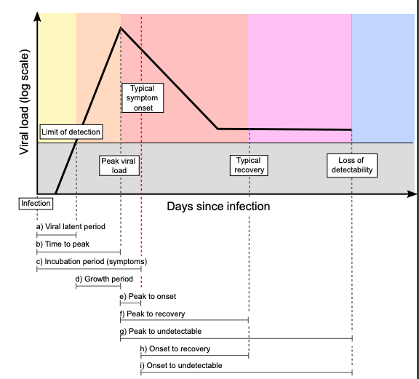
Ct values in large pools
“Although there are challenges to relying on single Ct values for individual-level decision making, the aggregation of many such measurements from a population contains substantial information. These results demonstrate how population-level distributions of Ct values can provide information on important epidemiologic questions of interest, even from a single cross-sectional survey.” (Hay et al., 2021)
Notes:
https://www.medrxiv.org/content/10.1101/2020.10.08.20204222v2.full.pdf

Slide 32
Objectives
Pooled testing in non-IID settings: effective parameters, effect on PPA and tests per sample
Impact of heterogeneity on predictive metrics
Extrapolating to global prevalence estimates
Develop recommendations for testing based on groups of differing risks

Slide 33
Summary
Specimen collection process could have natural correlation process (e.g. dorms, offices) that we want to account for
Two effects
Correlations: higher probability of positive pool → potentially need to lower pool size, but reduces concerns about dilution effects
Heterogeneity: gives idea of distributions on the values (average number of tests per sample is a RV, how sure are we of the gains that we are proposing?)
Given the uncertainty we have in the parameters themselves, how does this translate into our estimates?
Higher heterogeneity means wider spread
Notes:
Especially interested in how we can make this useful / interesting to people working on COVID / infectious disease
If we see gains on average, are there scenarios where it might be worse?
Also a reflection of how certainty we are of our estimates (we use informative parameters, but they are still guesses)
Narrow spread = consistent gains; Wide spread = not very confident in average value
E.g. a gain of 40% on average, is the uncertainty (30-50%) or (-10-50%)?

Slide 34
acknowledgements
Holmes Group:
Claire Donnat, PhD
Susan Holmes, PhD
Pinsky Lab:
Hannah Wang, MD
Catherine A. Hogan, MD, MSc
Benjamin A. Pinsky, MD, PhD

Slide 35
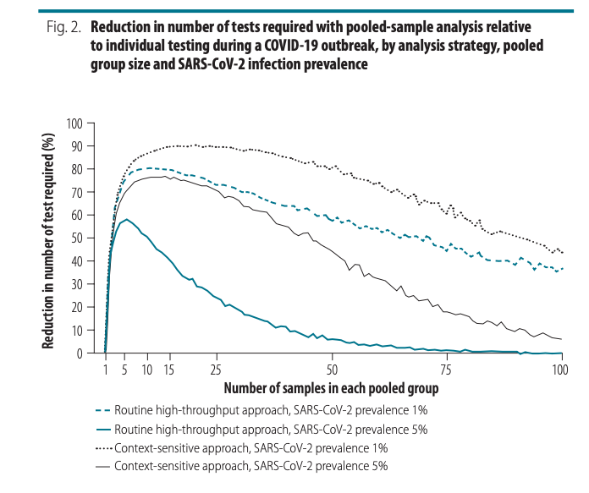
Pooling strategy
Deckert et al. (2020) simulated routine and “context-sensitive” pooling approaches
Parameters:
Population size: 150 000 or 15 000
Prevalence: 0.5 to 20%, in incremental steps of 0.5%
Group size: 2 to 100
Routine: # infected individuals in each group distributed binomial(overall prevalence, group size)
Context-sensitive:
Within group infection prevalence decreases (non-linearly) with increasing group size as group becomes more heterogeneous
# infected individuals in each group distributed binomial(within-group prevalence, group size).
Notes:
Routine: with a prevalence of 1%, selecting a group size between 5 and 50 implies at least 58% fewer tests. With a high prevalence of 10%, a reduction in the number of tests of around 40% can still be achieved but the selected group size must be close to 3. When the prevalence is high and the group size is large, the number of tests required slightly exceeds the number required for individual testing
Context-sensitive: with a prevalence of 1%, selecting a group size between 5 and 50 implies at least 76% fewer tests. With a high prevalence of 10%, a reduction of around 65% is still achievable, though the selected group size must be close to 10 (data repository)
https://www.ncbi.nlm.nih.gov/pmc/articles/PMC7463190/pdf/BLT.20.257188.pdf

Slide 36
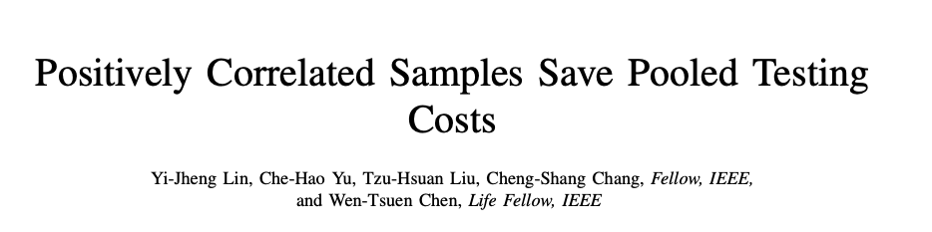
Deckert et al. (2020) showed by simulation that pooled samples from homogeneous groups of similar people lead to cost reduction for the Dorfman two-stage method
Lin et al. (2020) provide mathematical proof for this finding
Model the arrival process to a COVID-19 testing site: show that the expected relative cost for positively correlated samples is not higher than that of i.i.d. samples with the same prevalence rate
Do not account for other factors – e.g. dilution, analytic sensitivity
Notes:
expected relative cost = the ratio of the expected number of tests required by the group testing method to the number of tests required by the individual testing
Article available pre-print, Nov 2020 https://arxiv.org/pdf/2011.09794.pdf

Slide 37
overview
BACKGROUND
Mass testing is needed control the COVID-19 outbreak, but testing resources limited
Pooled testing: advantages and challenges
STANFORD POOLED TESTING PERFORMANCE STUDY
Characterized effect of dilution on analytical sensitivity through sample pooling using empiric data and modeling
Assume all samples are IID
CORRELATION STRUCTURES
How does test sensitivity change when independent and identically distributed assumptions are violated?
Two models for introducing correlations
Correlation in Ct values
Correlation at transmission level (network model)

Slide 38
“SARS-CoV-2 Pooled Test Performance” (Pinsky Lab, Stanford)
LAB METHODS:
Tested 1,648 prospectively-pooled specimens
C_{t} result between 40-45 = indeterminate result; > 45 = negative
STATISTICAL METHODS:
Developed simulation model to estimate the effects of dilution on positive percent agreement (PPA) and efficiency of a two-stage pooled testing algorithm
Validated model using the empiric lab data
Assumed independence between samples in same pool
OBJECTIVE:
Develop empirically validated model to predict optimal pool size and associated expected PPA based on limit of detection, C_{t} value distribution, and proportion of positive tests.
Definition {PPA}: Proportion of comparative/reference method positive results in which the test method result is positive. Sensitivity requires knowing the true status of the subject.
Notes:
In a pool with x people positive out of X total, this is the expected sensitivity (PPA).
Type of tests used: using three different NAATs for SARS-CoV-2: a laboratory-developed real-time reverse transcription PCR (rRT-PCR) assay targeting the E gene, and two commercially-available Panther System assays targeting ORF1ab
PPA: PPA is an agreement statistic for diagnostic tests. To calculate sensitivity, the true state of the subject, whether the subject does have the illness or condition, must be known.
https://analyse-it.com/blog/2020/4/diagnostic-accuracy-sensitivity-specificity-versus-agreement-ppa-npa-statistics

Slide 39
Modeling PPA (adapted from pinsky et al.)
(1) Fit C_{t} values of positive samples to candidate continuous probability distributions, select best-fitting distribution: slight negative skewness → Weibull distribution (shape = 4.55, scale parameters = 29.86)
(2) Generate set of random C_{t} values: sample 50,000 times from this distribution (base case); shift C_{t} values to have 5-30% of values above LoD (to test differing viral loads)
Notes:
Best fitting distribution selected based on the Bayesian information criterion and Kolmogorov-Smirnov statistic (0.0436).

Slide 40
Modeling ppa (adapted from pinsky et al.)
(3) Apply model
Input parameters: PPA depends on
1) Proportion of positive tests: 0.1%, 1.0%, 3.0%, 5.0%, 10.0%, 15.0%
2) Assay analytical sensitivity:
95% assay limit of detection (LoD) C_{t} = 35
C_{t} value corresponding to the probability of detecting 95% of true positives (95% LoD). Specimens with C_{t} > LoD are assigned a decreasing probability of detection based on a probit regression curve (derived from empiric data)
3) Viral load distribution:
% of individual amplified C_{t} values above the LoD- 5%, 10%, 15%, 20%, 25%, 30%
4) Pool size: 1-20
Notes:
at each Ct value you have a probability of detection; above LoD (35) definitely negative, below the LoD its stochastic and there is a probability of being positive
lower Ct means easier detection
increasing proportion of positive tests is like increasing prevalence in the general population

Slide 41
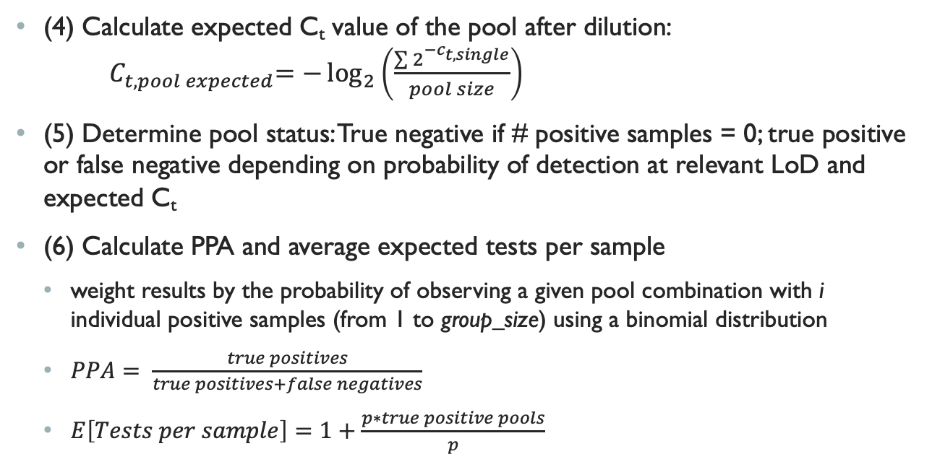
Modeling PPA (adapted from pinsky et al.)
(4) Calculate expected C_{t} value of the pool after dilution: ${ C}_{t, pool expected}=−\log_{2}\left(\frac{\sum{2^{{−c}_{t, single}}}}{pool size}\right)$
(5) Determine pool status: True negative if # positive samples = 0; true positive or false negative depending on probability of detection at relevant LoD and expected C_{t}
(6) Calculate PPA and average expected tests per sample
weight results by the probability of observing a given pool combination with i individual positive samples (from 1 to group_size) using a binomial distribution
$PPA= \frac{true positives}{true positives+false negatives}$
$E\left[Tests per sample\right]=1+\frac{p∗true positive pools}{p}$

Slide 42
overview
BACKGROUND
Mass testing is needed control the COVID-19 outbreak, but testing resources limited
Pooled testing: advantages and challenges
STANFORD POOLED TESTING PERFORMANCE STUDY
Characterized effect of dilution on analytical sensitivity through sample pooling using empiric data and modeling
Assume all samples are IID
CORRELATION STRUCTURES
How does test sensitivity change when independent and identically distributed assumptions are violated?
Two models for introducing correlations
Correlation in Ct values
Correlation at transmission level (network model)

Slide 43
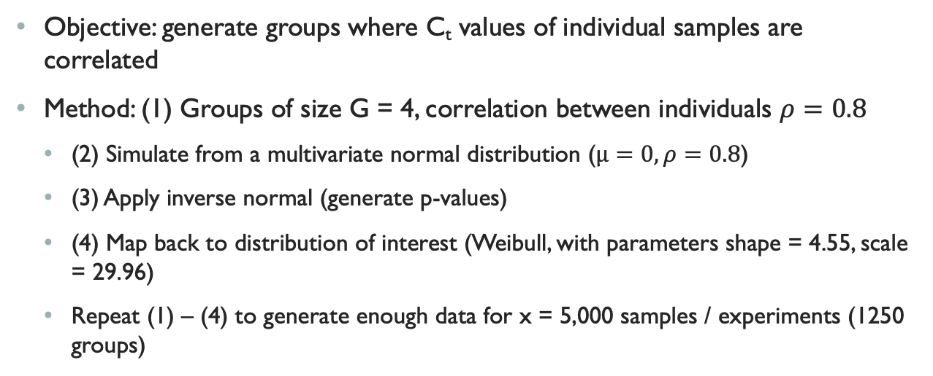
Correlation in ct values
Objective: generate groups where C_{t} values of individual samples are correlated
Method: (1) Groups of size G = 4, correlation between individuals $ρ=0.8$
(2) Simulate from a multivariate normal distribution ($μ=0, ρ=0.8$)
(3) Apply inverse normal (generate p-values)
(4) Map back to distribution of interest (Weibull, with parameters shape = 4.55, scale = 29.96)
Repeat (1) – (4) to generate enough data for x = 5,000 samples / experiments (1250 groups)

Slide 44
Experiments with correlated samples
Vary proportion of tests positive, pool size and percent of samples with Ct > LoD, then compare average tests per sample and positive percent agreement
Vary correlation structure and sampling :
Sample correlated data uniformly (destroy correlation structure)
Sample by correlated data groups
Vary fraction of group sampled (fraction = 1, ¾, ½)
Populate pools correlated data sampled by group (up to group size G), fill remaining spaces in pool with individuals sampled uniformly at random

Slide 45
Tradeoff between prevalence and pool size
Notes:
https://academic.oup.com/ajcp/article/153/6/715/5822023

